Slide 1
Memorization and generalization in the hippocampus
Mnemosyne team meeting
April, 28th 2026
Lucie Fontaine
PhD supervisor: Frédéric Alexandre

Slide 2
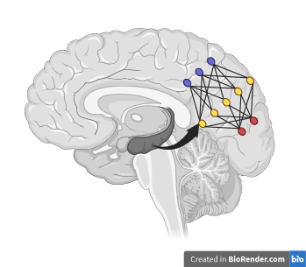
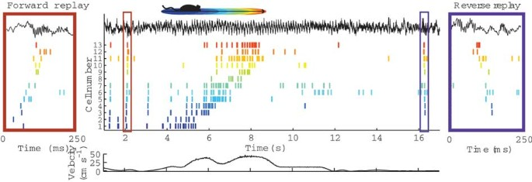
Two-stage model of memory (Buzsáki, 1989)
Hippocampal replay
From Carr et al. (2011), Nature Neuroscience.
Notes:
Rat – humain

Slide 3
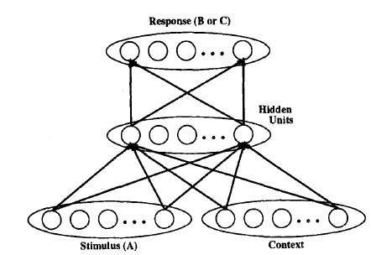
Complementary Learning Systems theory (McClelland et al., 1995)
Catastrophic forgetting in the AB-AC paradigm
A-B | A-C
Locomotive-dishtowel | Locomotive-banana
Table-street | Table-basket
Carpet-idea | Carpet-pencil
From McClelland et al. (1995), Psychological Review.

Slide 4
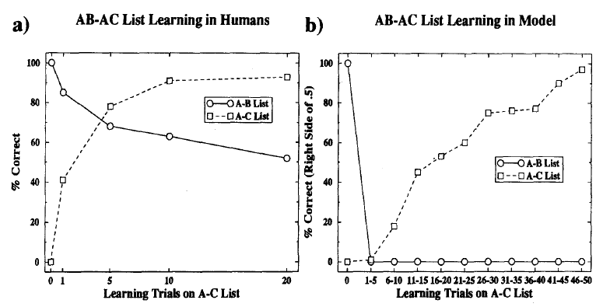
Complementary Learning Systems theory (McClelland et al., 1995)
Catastrophic forgetting in the AB-AC paradigm
A-B | A-C
Locomotive-dishtowel | Locomotive-banana
Table-street | Table-basket
Carpet-idea | Carpet-pencil
From McCloskey and Cohen (1989), The Psychology of Learning and Motivation.

Slide 5
Complementary Learning Systems theory (McClelland et al., 1995)
Step 1: A-B
Step 2: A-C interleaved with A-B
Locomotive-dishtowel
Table-street
Carpet-idea
…
Locomotive-banana
Carpet-idea
Table-basket
Carpet-idea
Carpet-pencil
Table-street
…

Slide 6
Complementary Learning Systems theory (McClelland et al., 1995)
The hippocampus quickly stores the details of individual experiences.
The neocortex slowly extracts structure from experiences.
Hippocampal replay interleaves new experiences with other experiences to integrate them into the structure of the neocortex.

Slide 7
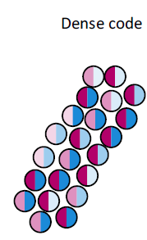
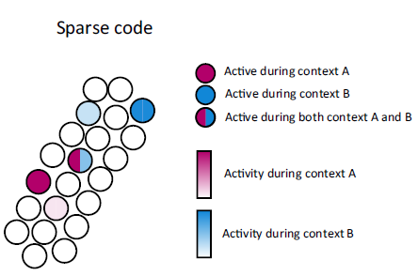
Complementary Learning Systems theory (McClelland et al., 1995)
Structure discovery in the neocortex
Fast storage in the hippocampus
High overlap between contexts
Generalization accross contexts
Low overlap between contexts
Fast memorization of individual contexts
From Spanne and Jörntell (2015), Trends in Neurosciences.

Slide 8
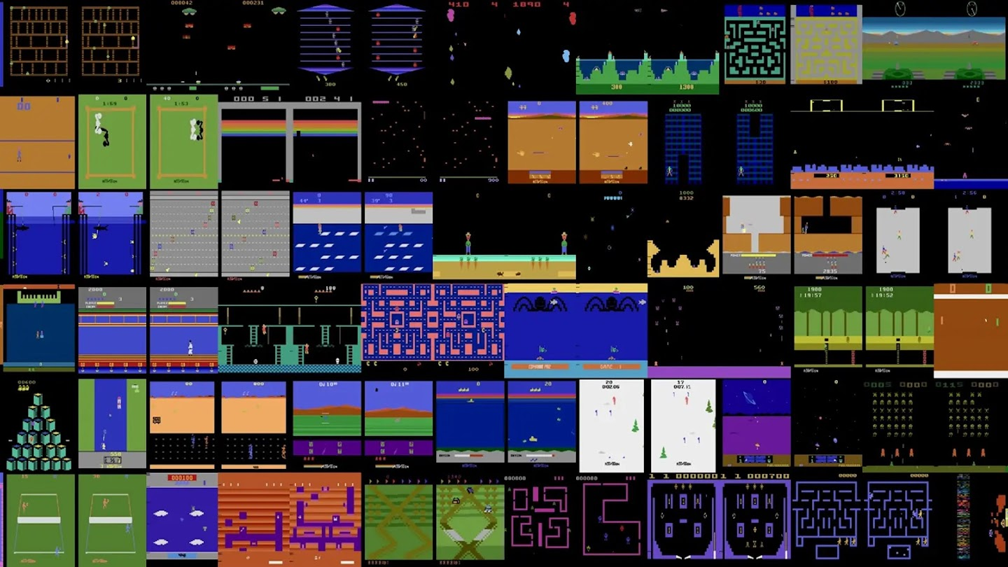

Experience replay in machine learning
Continual learning
Reinforcement learning agents
MNIST digits incremental classification
Atari 2600 games
From van De Ven (2020), Nature Communications

Slide 9
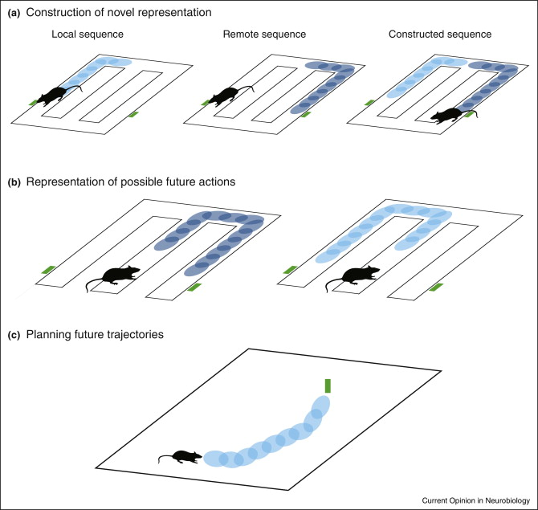
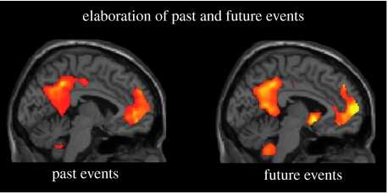
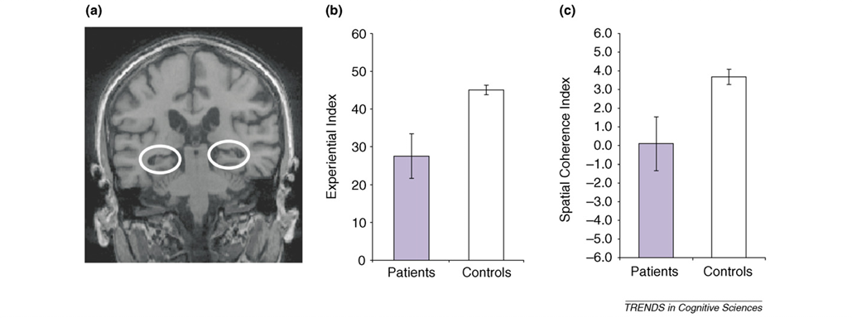
Additional roles of replay
Prospective trajectories in rodents
Scene construction in humans
From Schacter and Addis (2007), Philosophical Transactions of the Royal Society B
From Wikenheiser and Redish (2015), Current Opinion in Biology
From Hassabis and Maguire (2007), Trends in cognitive science

Slide 10
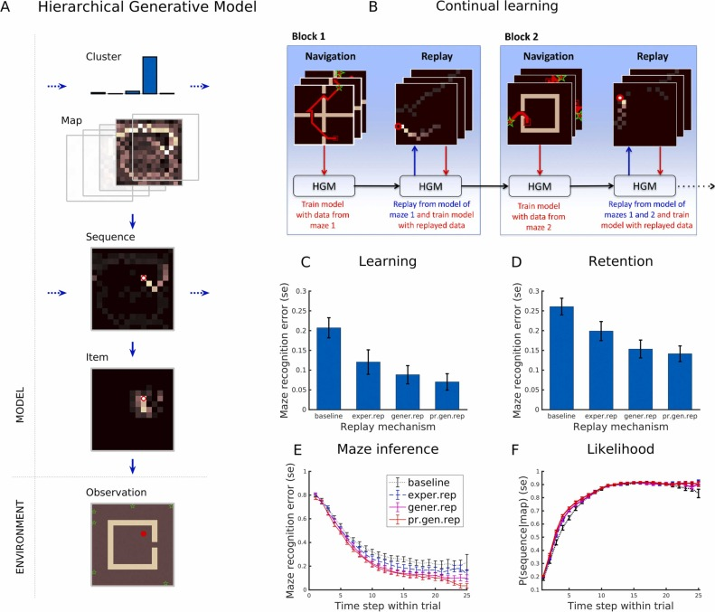
Generative replay as sampling from a generative model
From Stoianov et al. (2022), Progress in Neurobiology

Slide 11
Generative replay as sampling from a generative model
Biological
implementation?
From Stoianov et al. (2022), Progress in Neurobiology

Slide 12
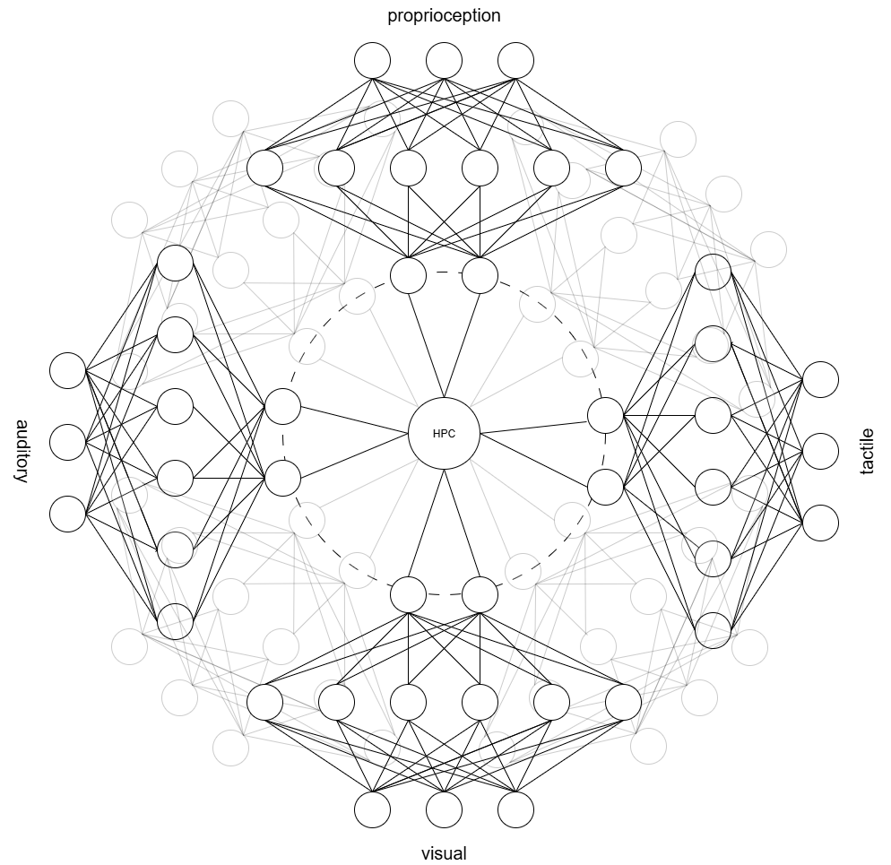
Location of the hippocampus

Slide 13
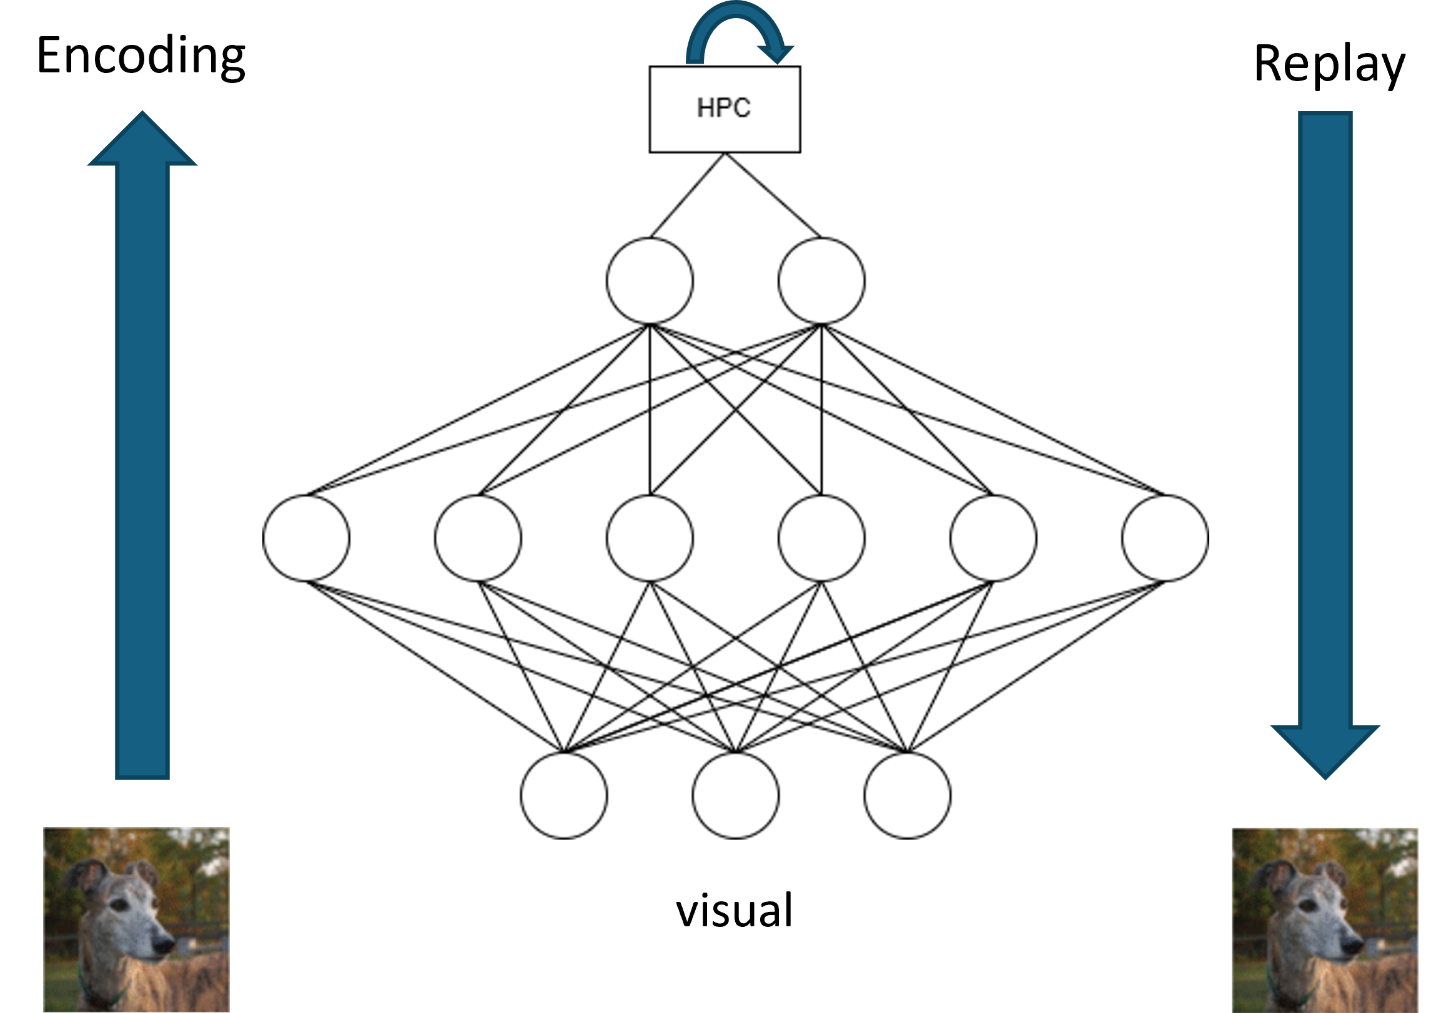
Interactions with the neocortex

Slide 14
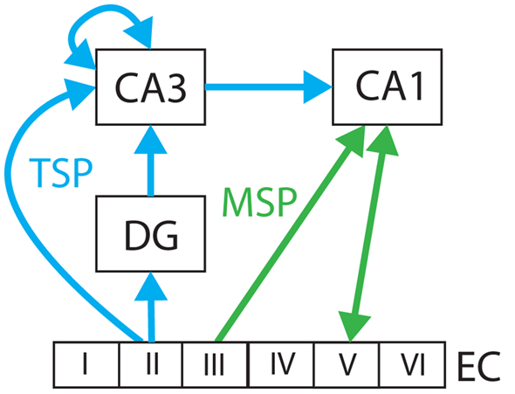
Hippocampal circuit
From Ketz et al. (2013), PLoS computational biology
Neocortex

Slide 15
Synaptic plasticity in the hippocampus
Long-term Hebbian plasticity in all glutamergic synapses except DG-CA3
DG-CA3 synapses: primarily non-Hebbian plasticity
‘Cells that fire together, wire together’
From Ketz et al. (2013), PLoS computational biology

Slide 16
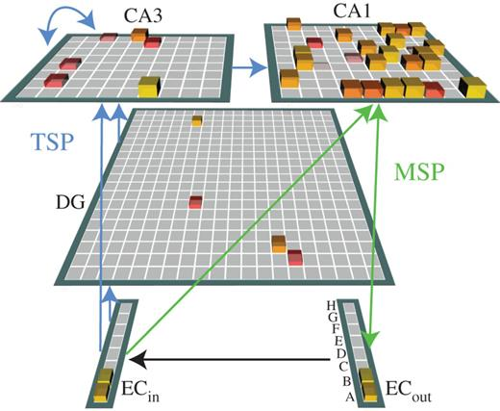
Computational theories of the hippocampus
From Schapiro et al. (2017), Philosophical Transactions of the Royal Society B
From Ketz et al. (2013), PLoS computational biology

Slide 17
Proposed neocortical-hippocampal network model
Fully-connected artificial neural networks:
Hippocampal circuit reflecting rat hippocampus cell number and sparsity in each region
Predictive coding network for the visual cortex
CA3
DG
CA1
EC
VC
LGN
plastic
fixed
Notes:
But du model
Mettre tous les rectangles avec des numéros

Slide 18
Proposed neocortical-hippocampal network model
Fully-connected artificial neural networks:
Hippocampal circuit reflecting rat hippocampus cell number and sparsity in each region
Predictive coding network for the visual cortex
CA3
DG
CA1
EC
VC
LGN
plastic
fixed
1
Notes:
But du model
Mettre tous les rectangles avec des numéros

Slide 19
Proposed neocortical-hippocampal network model
Fully-connected artificial neural networks:
Hippocampal circuit reflecting rat hippocampus cell number and sparsity in each region
Predictive coding network for the visual cortex
CA3
DG
CA1
EC
2
VC
LGN
plastic
fixed
Notes:
But du model
Mettre tous les rectangles avec des numéros

Slide 20
Proposed neocortical-hippocampal network model
Fully-connected artificial neural networks:
Hippocampal circuit reflecting rat hippocampus cell number and sparsity in each region
Predictive coding network for the visual cortex
3
CA3
DG
CA1
EC
VC
LGN
plastic
fixed
Notes:
But du model
Mettre tous les rectangles avec des numéros

Slide 21
Proposed neocortical-hippocampal network model
Fully-connected artificial neural networks:
Hippocampal circuit reflecting rat hippocampus cell number and sparsity in each region
Predictive coding network for the visual cortex
CA3
DG
CA1
EC
4
VC
LGN
plastic
fixed
Notes:
But du model
Mettre tous les rectangles avec des numéros

Slide 22
Proposed neocortical-hippocampal network model
Fully-connected artificial neural networks:
Hippocampal circuit reflecting rat hippocampus cell number and sparsity in each region
Predictive coding network for the visual cortex
CA3
DG
CA1
EC
5
VC
LGN
plastic
fixed
Notes:
But du model
Mettre tous les rectangles avec des numéros

Slide 23













Predicting coding model of the neocortex
Predictive coding network
0
CA3
Prediction
Prediction errors
$$ξ_{2}$$
$$ξ_{2}=φ_{2}−0$$
DG
CA1
Entorhinal cortex (EC)
$$φ_{2}$$
EC
$$W_{1}$$
$$W_{1}^{⊤}diag\left[f′\left(W_{1}φ_{2}+b_{1}\right)\right]$$
f
$$ξ_{1}$$
$$ξ_{1}=φ_{1}−{f(W}_{1}φ_{2}+b_{1})$$
VC
Visual cortex (VC)
$$φ_{1}$$
plastic
$$W_{0}$$
$$W_{0}^{⊤}$$
LGN
fixed
$$ξ_{0}$$
$$ξ_{0}=x−W_{0}φ_{1}$$
1 Neocortex
Lateral geniculate nucleus (LGN)
$$x$$

Slide 24
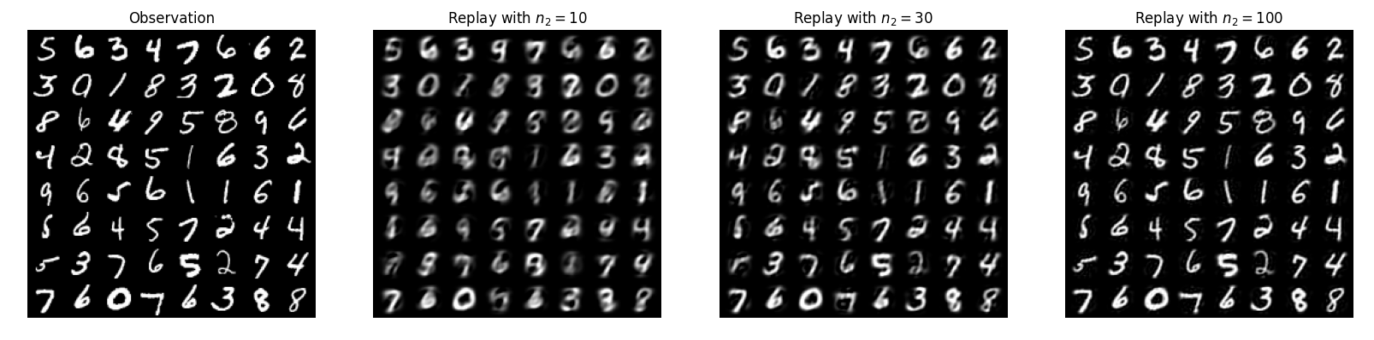
Experience replay from EC
CA3
DG
CA1
EC
VC
Under review at ICANN 2026
LGN
plastic
fixed
1 Neocortex

Slide 25
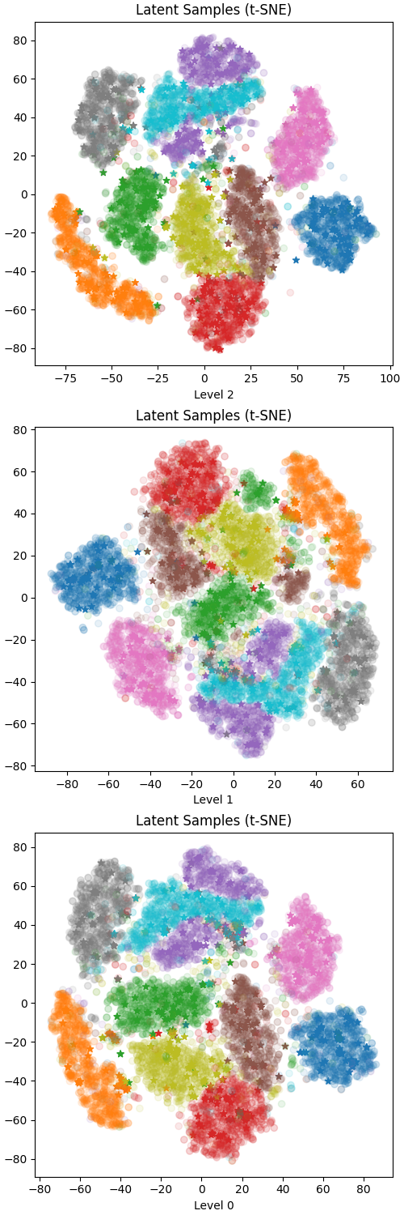
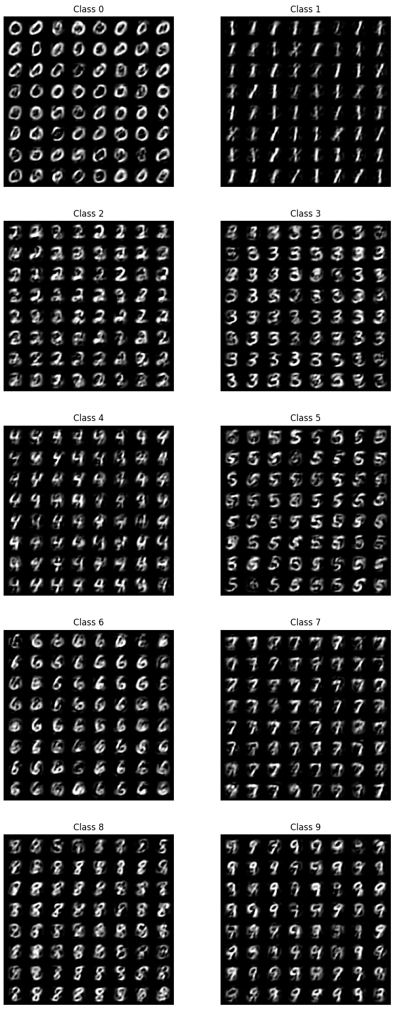
Generative replay from EC
EC
CA3
DG
CA1
VC
EC
VC
LGN
LGN
plastic
fixed
1 Neocortex
Under review at ICANN 2026

Slide 26
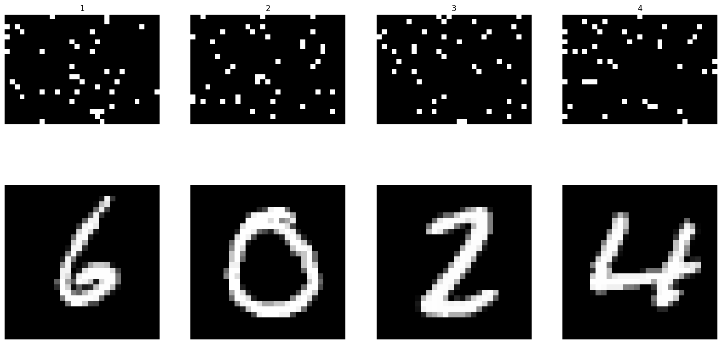
Pattern separation
Sparsity of DG and CA3 implemented with a k-winners-take-all mechanism
CA3
DG
CA1
EC
CA3
2 Encoder
VC
LGN
LGN
plastic
fixed

Slide 27
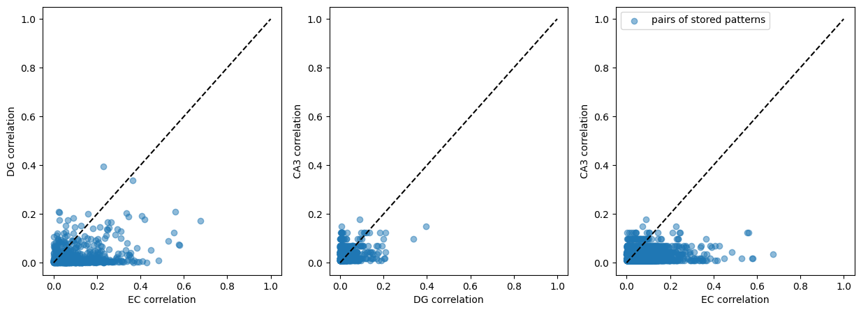
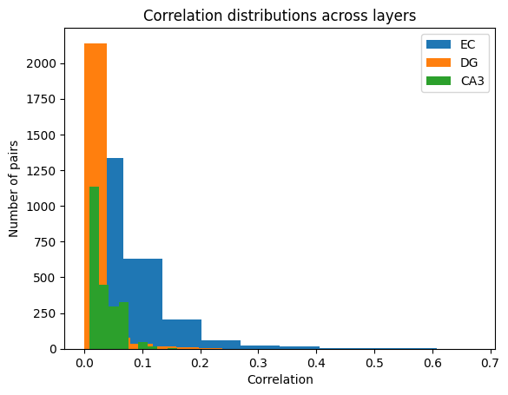
Pattern separation
Pearson correlation
CA3
CA3
DG
CA1
EC
2 Encoder
VC
LGN
plastic
fixed

Slide 28
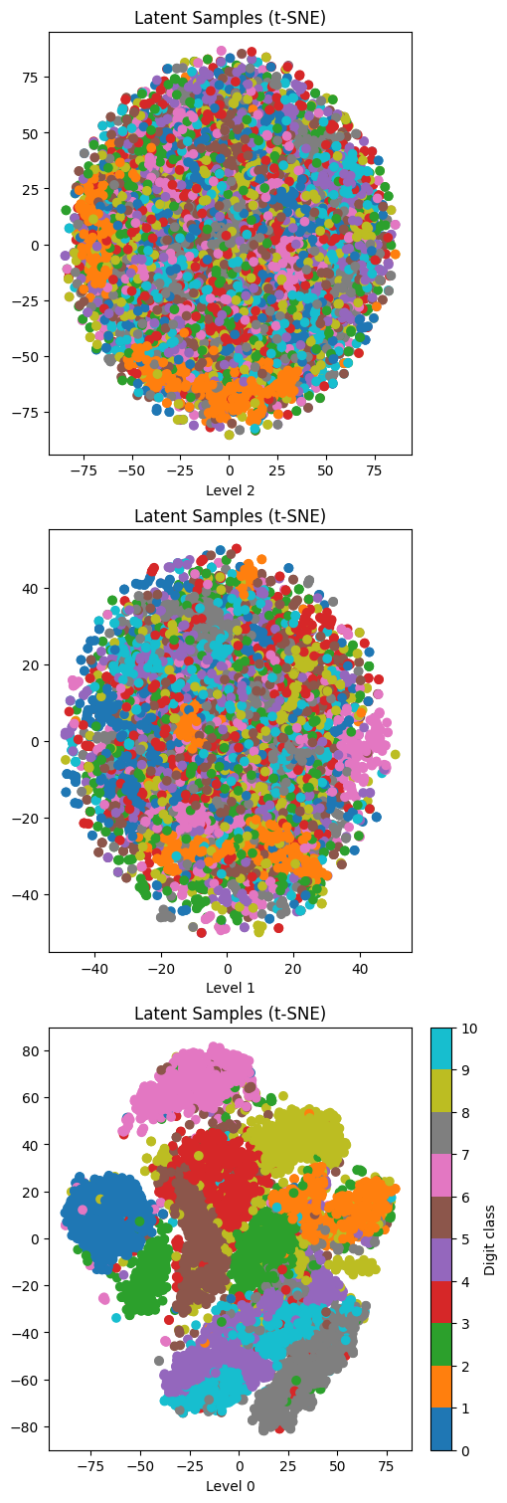
Pattern separation
CA3
CA3
DG
CA1
EC
DG
2 Encoder
VC
plastic
EC
LGN
fixed

Slide 29
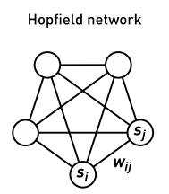
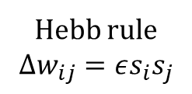

Autoassociation in CA3
$680$neurons
$64$patterns are stored with the Hebb rule
3
CA3
Hebb rule
$${Δw}_{ij}=εs_{i}s_{j}$$
DG
CA1
EC
VC
LGN
plastic
fixed
Notes:
Hebb rule

Slide 30
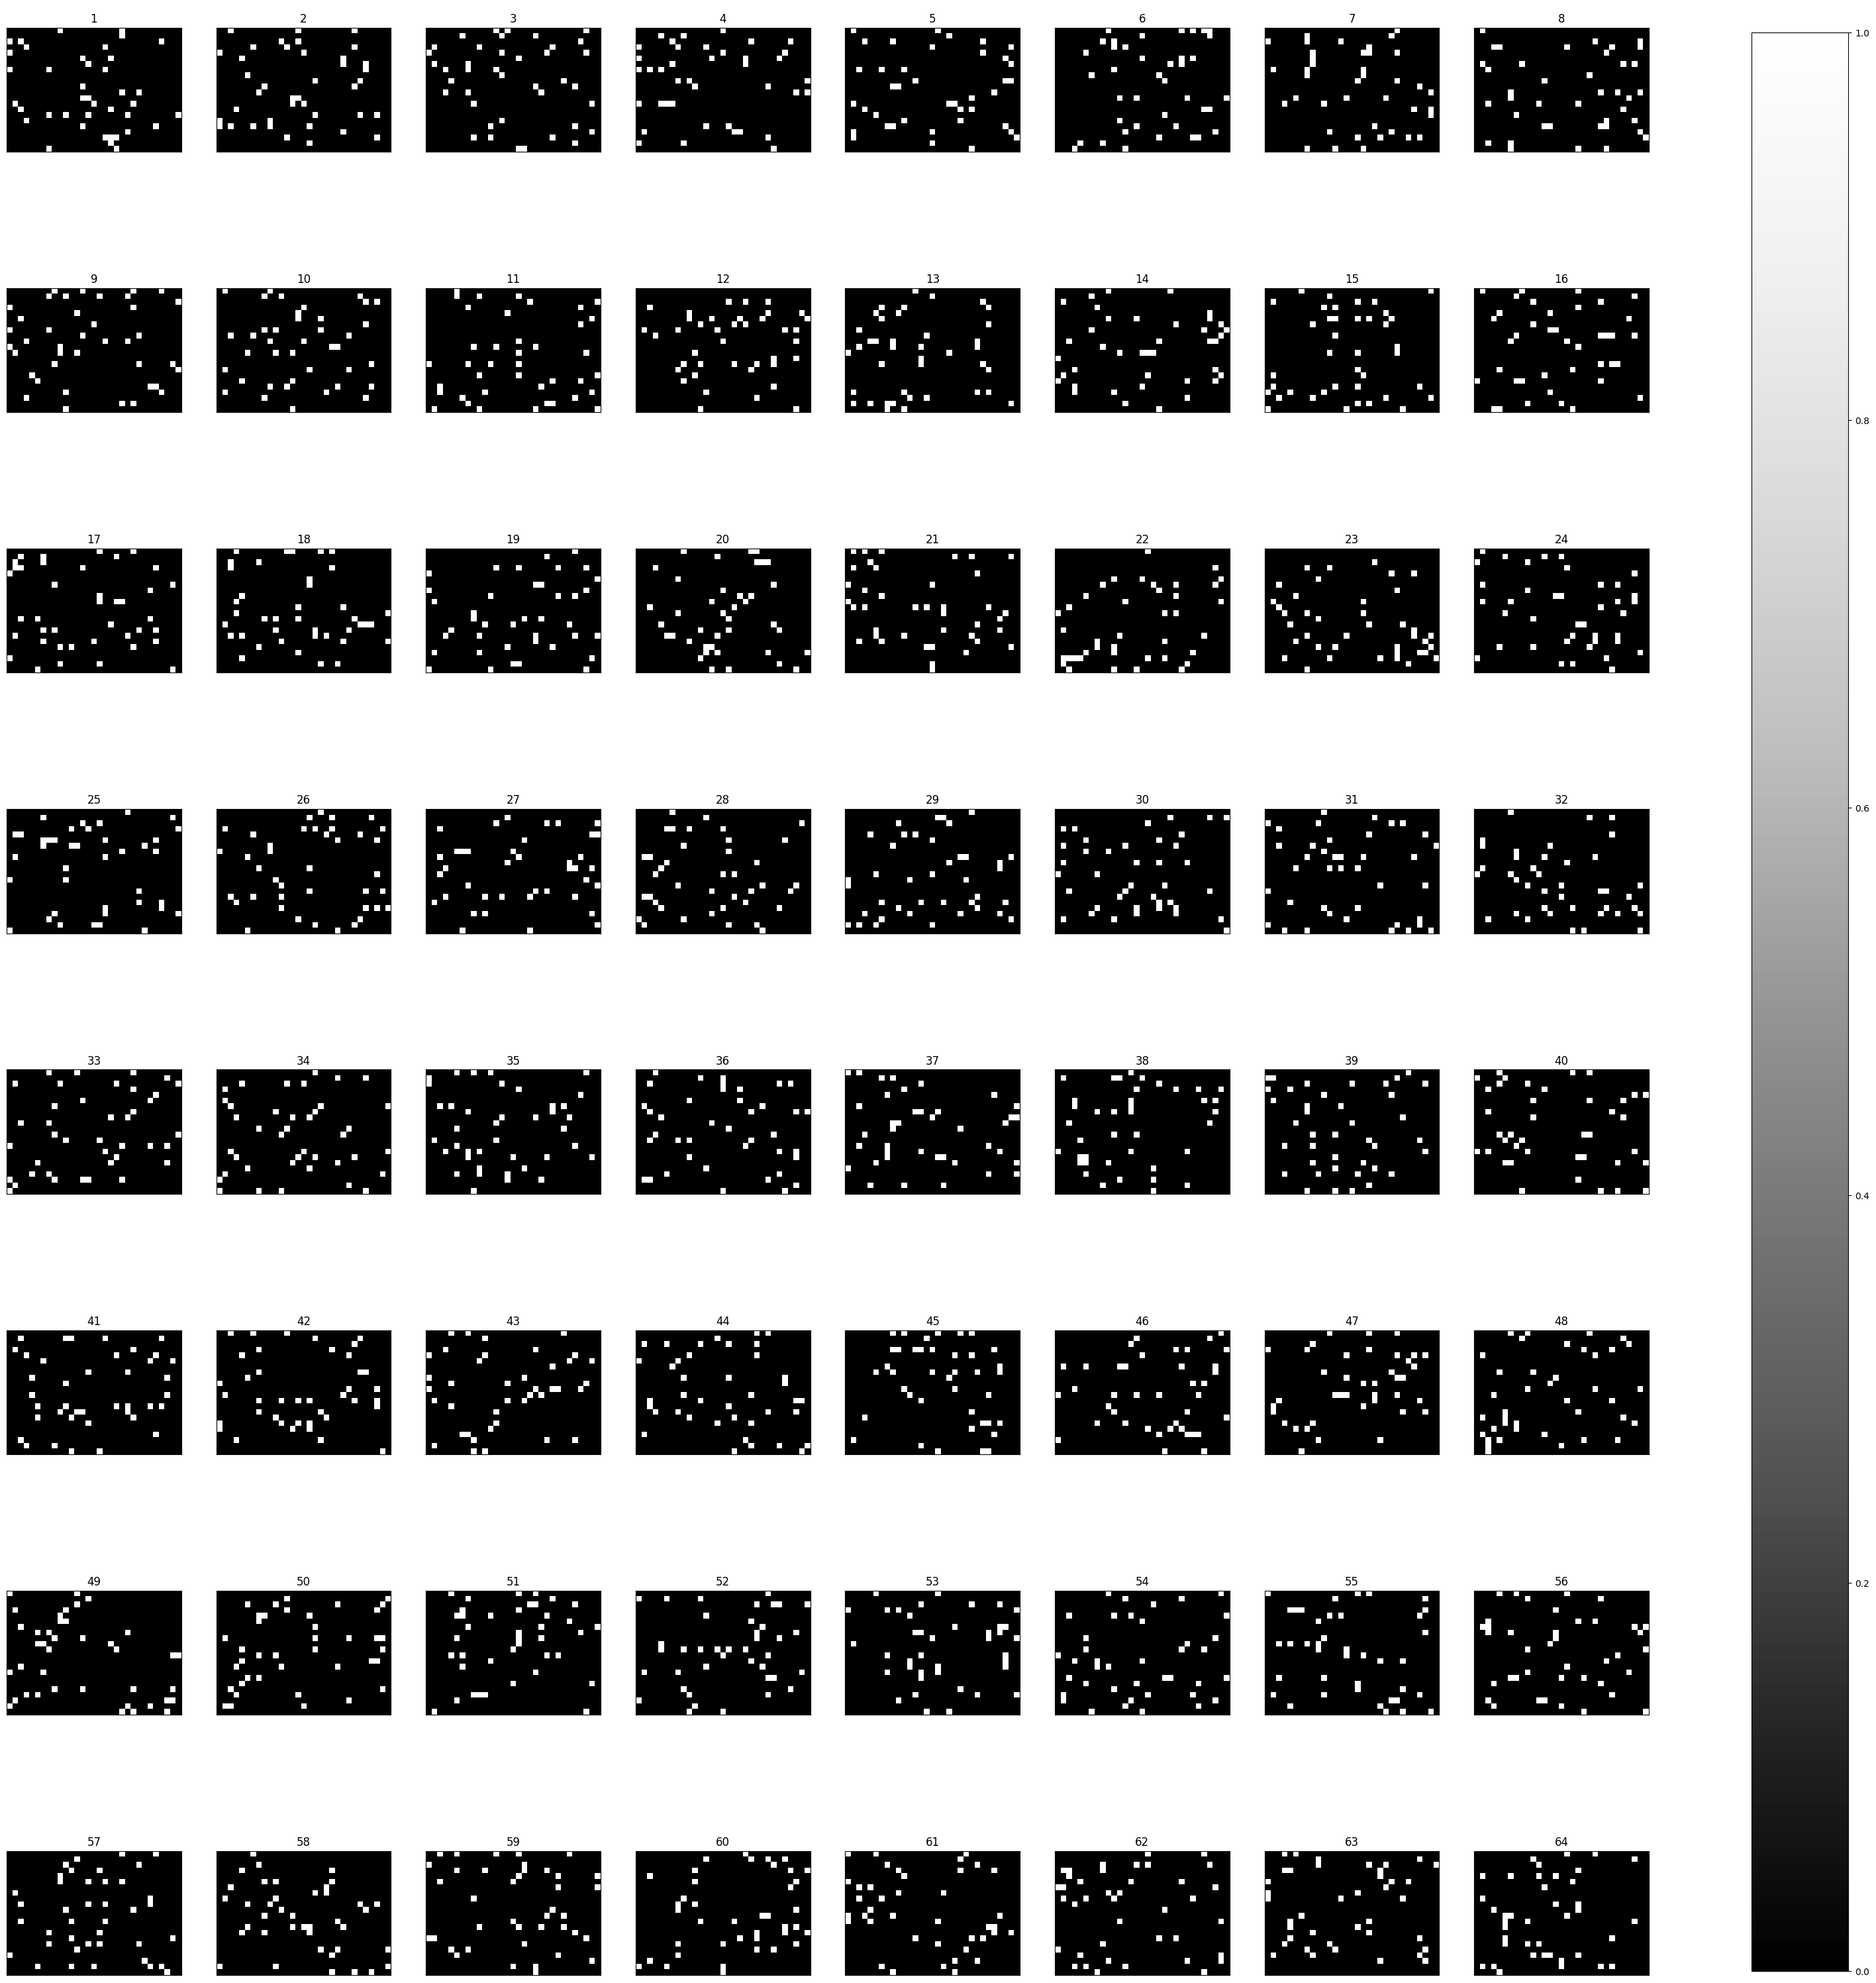
Autoassociation in CA3
$680$neurons
$64$patterns are stored with the Hebb rule
Hebb rule
$${Δw}_{ij}=εs_{i}s_{j}$$
Notes:
Hebb rule

Slide 31
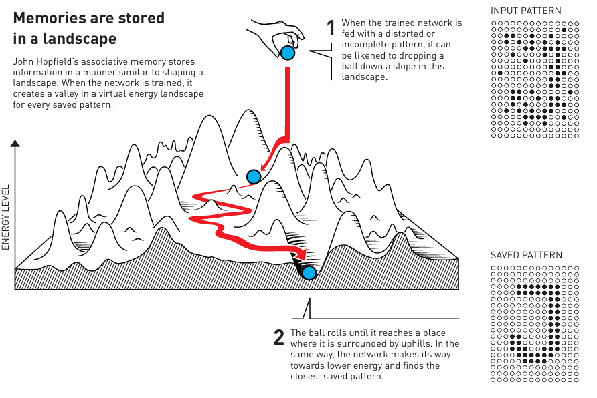
Hopfield networks
From nobelprize.org

Slide 32
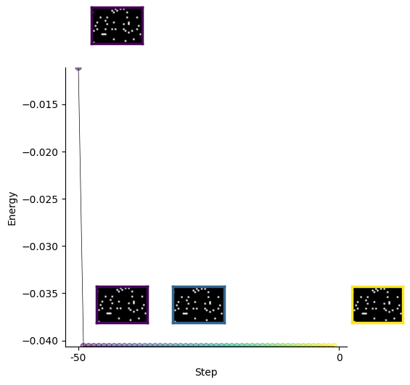
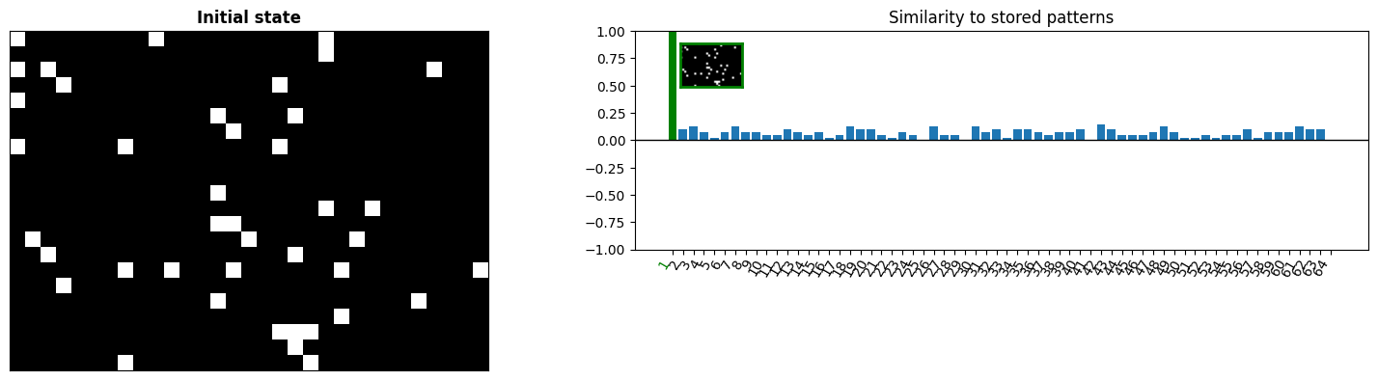

Perturbing an attractor…

Slide 33

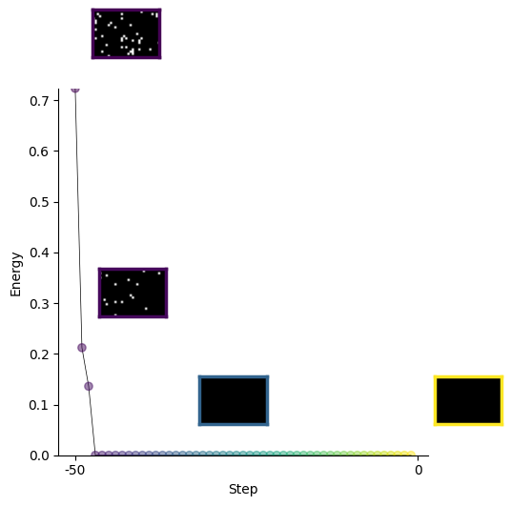
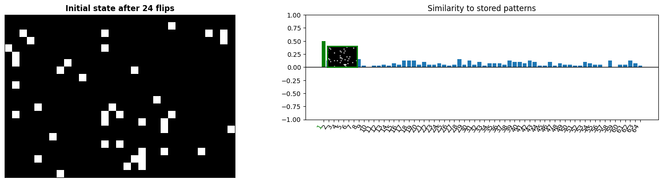
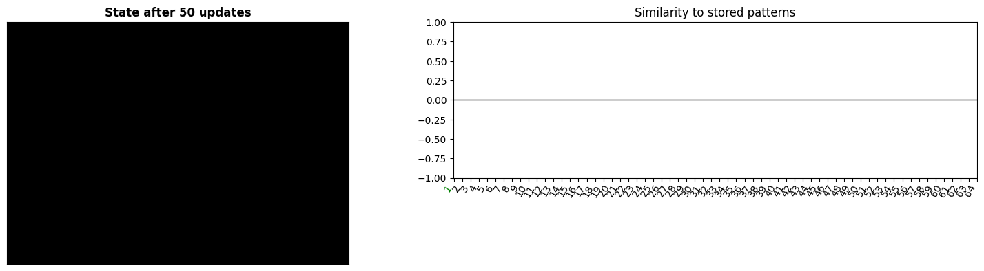
Until it cannot be recalled anymore

Slide 34
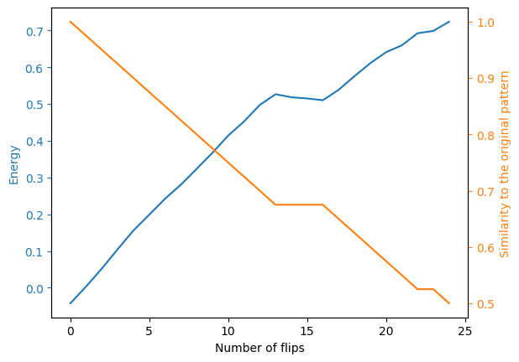
Until it cannot be recalled anymore

Slide 35




Heteroassociation in EC-CA3
CA3
CA3
DG
CA1
EC
$$z_{EC}^{(1)}$$
$$z_{EC}^{(2)}$$
$$z_{EC}^{(3)}$$
$$z_{EC}^{(4)}$$
EC
4
VC
LGN
plastic
LGN
fixed
Notes:
zEC
Apprentissage

Slide 36



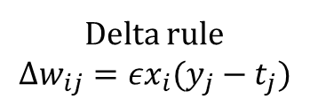









Heteroassociation in EC-CA3
$$t^{(1)}$$
$$t^{(2)}$$
$$t^{(3)}$$
$$t^{(4)}$$
Pattern associator
$$y_{j}=\sum_{i}{w_{ij}x_{i}}$$
CA3
CA3
$$y_{j}$$
v
$$w_{ij}$$
Delta rule
$$Δw_{ij}={εx}_{i}(y_{j}−t_{j})$$
EC
$$x_{i}$$
$$x^{(1)}$$
$$x^{(2)}$$
$$x^{(3)}$$
$$x^{(4)}$$
EC
Notes:
zEC
Apprentissage

Slide 37
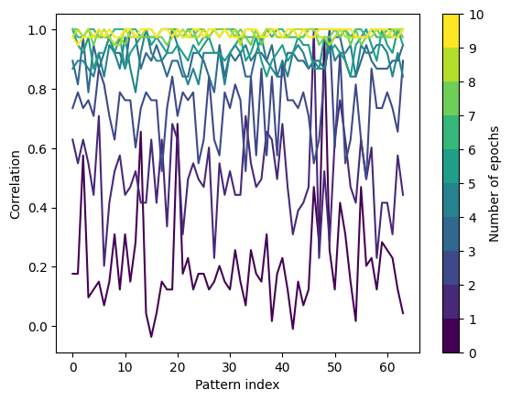

Heteroassociation in EC-CA3
Pattern associator
Performance on the 64 patterns: $Corr\left(y, t\right)$
$$y_{j}$$
$$y_{j}=\sum_{i}{w_{ij}x_{i}}$$
CA3
v
$$w_{ij}$$
Delta rule
$$Δw_{ij}={εx}_{i}(y_{j}−t_{j})$$
EC
$$x_{i}$$
Notes:
zEC
Apprentissage

Slide 38
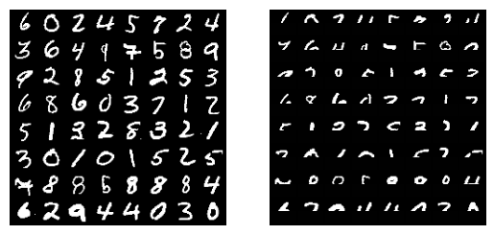
Pattern completion
Stored images
Observations
CA3
DG
CA1
EC
4
VC
LGN
plastic
fixed

Slide 39
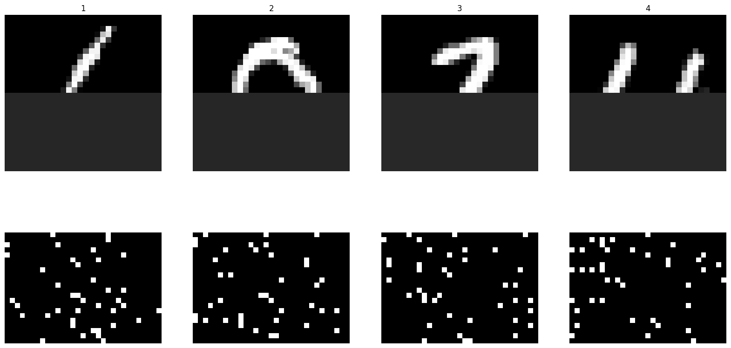
Pattern completion
CA3
DG
CA1
Recalled
patterns
EC
correlation
4
Stored
patterns
VC
LGN
plastic
fixed

Slide 40
Pattern completion
CA3
DG
CA1
Recalled
patterns
EC
correlation
4
Stored
patterns
VC
LGN
plastic
fixed

Slide 41
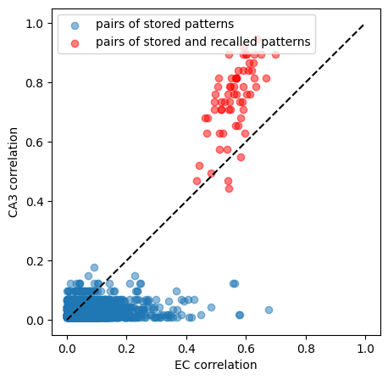
Pattern completion
CA3
64
patterns
DG
CA1
EC
4
VC
LGN
plastic
fixed

Slide 42
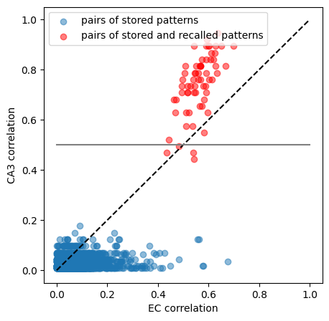


Pattern completion
Theoretical correlation threshold to converge to a stored pattern $≈0.5$
3
CA3
DG
CA1
Converge to stored pattern
EC
Threshold $≈0.5$
VC
LGN
plastic
fixed
Notes:
Démonstration théorique
Conclusion: ce que ça peut apporter aux neurosciences: connaissances et méthodes

Slide 43
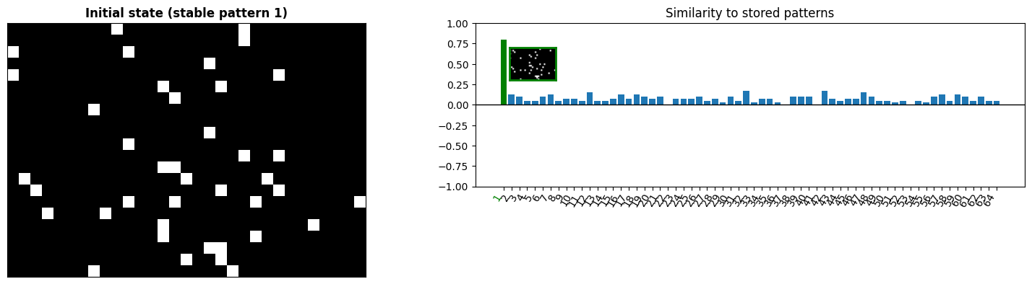
Pattern completion
60 out of the 64 recalled patterns converge to the stored patterns.
3
CA3
DG
CA1
EC
VC
LGN
plastic
fixed
Notes:
67/68

Slide 44
Pattern completion
60 out of the 64 recalled patterns converge to the stored patterns.
3
CA3
DG
CA1
EC
VC
LGN
plastic
fixed

Slide 45
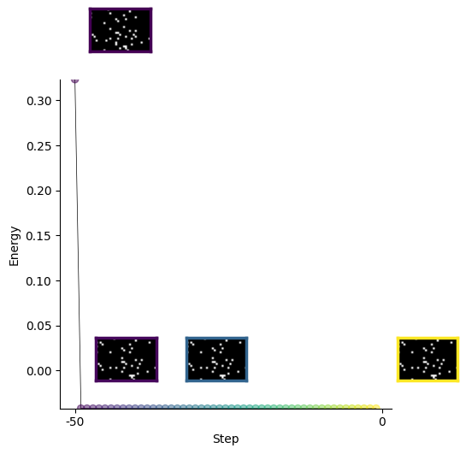
Pattern completion
60 out of the 64 recalled patterns converge to the stored patterns.

Slide 46




Encoding to CA3
CA3
CA3
DG
CA1
Encoder
EC
$$z_{EC}^{(1)}$$
$$z_{EC}^{(2)}$$
$$z_{EC}^{(3)}$$
$$z_{EC}^{(4)}$$
EC
2 Encoder
VC
LGN
plastic
fixed
LGN

Slide 47








Decoding back to EC
$$x^{(1)}$$
$$x^{(2)}$$
$$x^{(3)}$$
$$x^{(4)}$$
CA3
CA3
DG
CA1
Decoder
EC
$$t^{(1)}$$
$$t^{(2)}$$
$$t^{(3)}$$
$$t^{(4)}$$
EC
5 Decoder
VC
LGN
plastic
fixed
Notes:
Ajouter z_CA1

Slide 48


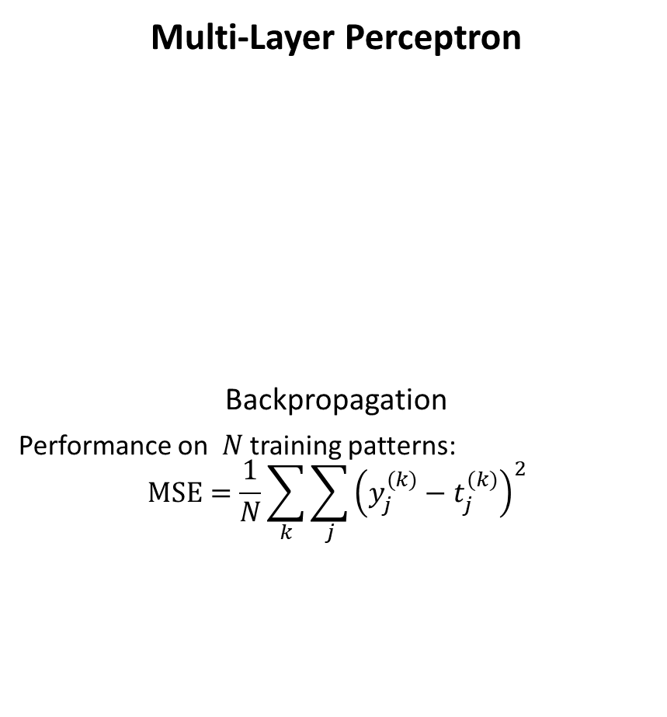
Decoding back to EC
$$x^{(1)}$$
$$x^{(2)}$$
$$x^{(3)}$$
$$x^{(4)}$$
Multi-Layer Perceptron
Backpropagation
Performance on $N$ training patterns:
$$MSE=\frac{1}{N}\sum_{k}{\sum_{j}{{\left(y_{j}^{(k)}−t_{j}^{(k)}\right)}^{2}}}$$
$$x_{i}$$
CA3
CA3
CA1
v
$$t^{(1)}$$
$$t^{(2)}$$
$$t^{(3)}$$
$$t^{(4)}$$
EC
EC
$$y_{j}$$

Slide 49
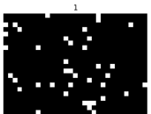
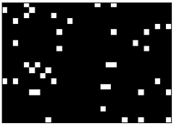

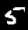







Experiments
Training the decoder on $N$ training images
Testing on training and validation images
CA3
Encoder
Decoder
$$t^{(1)}$$
$$y^{(1)}$$
EC
$$t^{(1)}$$
$${y′}^{(1)}$$
$$t$$
$$y$$
LGN
Training
Validation

Slide 50
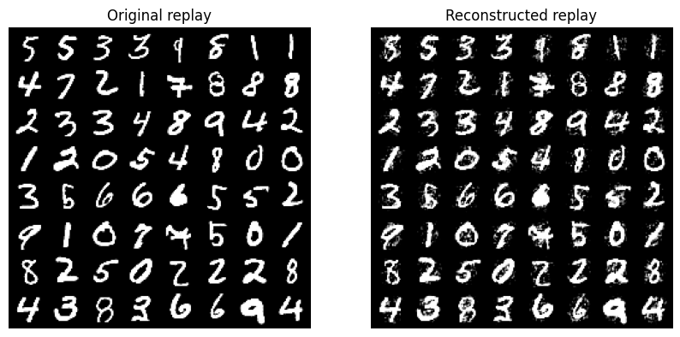



The decoder memorizes but does not generalize
Training the decoder on $N=64$ training images
Testing on training and validation images
Training
Validation

Slide 51




Generalization improves with more data at the expense of memorization
Training the decoder on
$N≈50000$ training images
Testing on training and validation images
Training
Validation

Slide 52


Sparsity favours memorization at the expense of generalization
Notes:
Titre/couleur

Slide 53
Monosynaptic pathway to CA1
CA3
DG
CA1
EC
5 Decoder
VC
LGN
plastic
fixed
From Ketz et al. (2013), PLoS computational biology

Slide 54
Monosynaptic pathway to CA1
k-sparse Autoencoder
Backpropagation
CA3
EC
DG
CA1
CA1
v
EC
5a Autoencoder
EC
VC
LGN
plastic
fixed

Slide 55


Monosynaptic pathway to CA1
Training the autoencoder on $N≈50000$ images
k-sparse Autoencoder
EC
CA1
v
EC

Slide 56

Generative replay in CA1
CA3
DG
CA1
EC
5a Autoencoder
VC
LGN
plastic
fixed

Slide 57

Generative replay in CA1
CA3
DG
CA1
EC
5a Autoencoder
VC
LGN
plastic
fixed

Slide 58

Pattern completion via the MSP
CA3
Stored images
Observations
DG
CA1
EC
5a Autoencoder
VC
LGN
plastic
fixed

Slide 59
Pattern completion via the MSP
CA3
Stored images
Recalled images
DG
CA1
EC
5a Autoencoder
VC
LGN
plastic
fixed

Slide 60




Heteroassociation in CA3-CA1
CA3
5b
CA3
DG
CA1
Encoder
$$z_{CA1}$$
CA1
EC
$$z_{EC}$$
EC
VC
plastic
LGN
LGN
fixed

Slide 61




Heteroassociation in CA3-CA1
Pattern associator
Similar performance as in EC-CA3
CA3
$$x_{i}$$
Delta rule
$$Δw_{ij}={εx}_{i}(y_{j}−t_{j})$$
CA3
$$w_{ij}$$
$$y_{j}$$
v
Encoder
$$z_{CA1}$$
CA1
CA1
$$z_{EC}$$
EC
LGN

Slide 62
Experience replay in CA3
CA3
DG
CA1
CA3
EC
5 Decoder
LGN
VC
LGN
plastic
fixed

Slide 63

Experience replay in CA3
CA3
DG
CA1
EC
5 Decoder
VC
LGN
plastic
fixed

Slide 64

Pattern completion via the TSP
CA3
DG
CA1
EC
5 Decoder
VC
LGN
plastic
fixed

Slide 65

Conclusion
Hippocampal model divided in two subsystems:
Trisynaptic pathway: memorization of salient experiences ($N=64$), enables experience replay
Monosynpatic pathway: cortex-like, generalizes across experiences ($N≈50000$), enabling generative replay
CA3
DG
CA1
EC
VC
LGN
plastic
fixed
Notes:
Donc la modélisation sert à…

Slide 66


Future work
CIFAR-10 dataset
Adapt predictive coding model to more complex inputs
Extension to navigation
Sequences
mEC: grid cells, place cells
Mechanisms underlying sampling to account for the diversity of replay sequences
EC

Slide 67

Future work
Adapt predictive coding model to more complex inputs
Extension to navigation
Sequences
mEC: grid cells, place cells
Mechanisms underlying sampling
Where
What

Slide 68


Future work
Adapt predictive coding model to more complex inputs
Extension to navigation
Sequences
mEC: grid cells, place cells
Mechanisms underlying sampling
From Chandra et al. (2025), Nature
From Ji et al. (2026), Nature Communications

Slide 69





Acknowledgements
Supervisor
Frédéric Alexandre
Other members of the Mnemosyne team

Slide 70
References
Carr, M. F., Jadhav, S. P., & Frank, L. M. (2011). Hippocampal replay in the awake state: a potential substrate for memory consolidation and retrieval. Nature neuroscience, 14(2), 147-153.
McClelland, J. L., McNaughton, B. L., & O'Reilly, R. C. (1995). Why there are complementary learning systems in the hippocampus and neocortex: insights from the successes and failures of connectionist models of learning and memory. Psychological review, 102(3), 419.
McCloskey, M., & Cohen, N. J. (1989). Catastrophic interference in connectionist networks: The sequential learning problem. In Psychology of learning and motivation (Vol. 24, pp. 109-165). Academic Press.
Spanne, A., & Jörntell, H. (2015). Questioning the role of sparse coding in the brain. Trends in neurosciences, 38(7), 417-427.
Van de Ven, G. M., Siegelmann, H. T., & Tolias, A. S. (2020). Brain-inspired replay for continual learning with artificial neural networks. Nature communications, 11(1), 4069.
Wikenheiser, A. M., & Redish, A. D. (2015). Decoding the cognitive map: ensemble hippocampal sequences and decision making. Current opinion in neurobiology, 32, 8-15.
Schacter, D. L., & Addis, D. R. (2007). The cognitive neuroscience of constructive memory: Remembering the past and imagining the future. Philosophical Transactions of the Royal Society B: Biological Sciences, 362(1481), 773-786.
Hassabis, D., & Maguire, E. A. (2007). Deconstructing episodic memory with construction. Trends in cognitive sciences, 11(7), 299-306.
Stoianov, I., Maisto, D., & Pezzulo, G. (2022). The hippocampal formation as a hierarchical generative model supporting generative replay and continual learning. Progress in Neurobiology, 217, 102329.
Ketz, N., Morkonda, S. G., & O'Reilly, R. C. (2013). Theta coordinated error-driven learning in the hippocampus. PLoS computational biology, 9(6), e1003067.
Schapiro, A. C., Turk-Browne, N. B., Botvinick, M. M., & Norman, K. A. (2017). Complementary learning systems within the hippocampus: a neural network modelling approach to reconciling episodic memory with statistical learning. Philosophical Transactions of the Royal Society B: Biological Sciences, 372(1711).
Kumaran, D., Hassabis, D., & McClelland, J. L. (2016). What learning systems do intelligent agents need? Complementary learning systems theory updated. Trends in cognitive sciences, 20(7), 512-534.
Strange, B. A., Witter, M. P., Lein, E. S., & Moser, E. I. (2014). Functional organization of the hippocampal longitudinal axis. Nature reviews neuroscience, 15(10), 655-669.
Chandra, S., Sharma, S., Chaudhuri, R., & Fiete, I. (2025). Episodic and associative memory from spatial scaffolds in the hippocampus. Nature, 638(8051), 739-751.
Ji, Z., Chu, T., Dong, X., Yu, C., Bush, D., Burgess, N., & Wu, S. (2026). Dynamical modulation of hippocampal replay through firing rate adaptation. Nature Communications.

Slide 71
Multiple choice question?
Name of the learning rule in MLP
Area of storage in the hippocampus
What is the type of coding in the hippocampus?
Which of the prizes did Hopfield win for his work on Hopfield networks? (Nobel Prize for Physics, Medicine, Turing Award, Fields Medal)
CLS pour expliquer … le catastrophic forgetting

